Slide 1
MGMT 6057 contemporary business management
Module 8: operations management

Slide 2
Agenda
Operations management activities
Supply chain and value chain
Types of production processes
Production operations management: planning, production management
Service operations management: planning, service management
Quality management
Outsourcing
Relevance for project managers and business owners

Slide 3
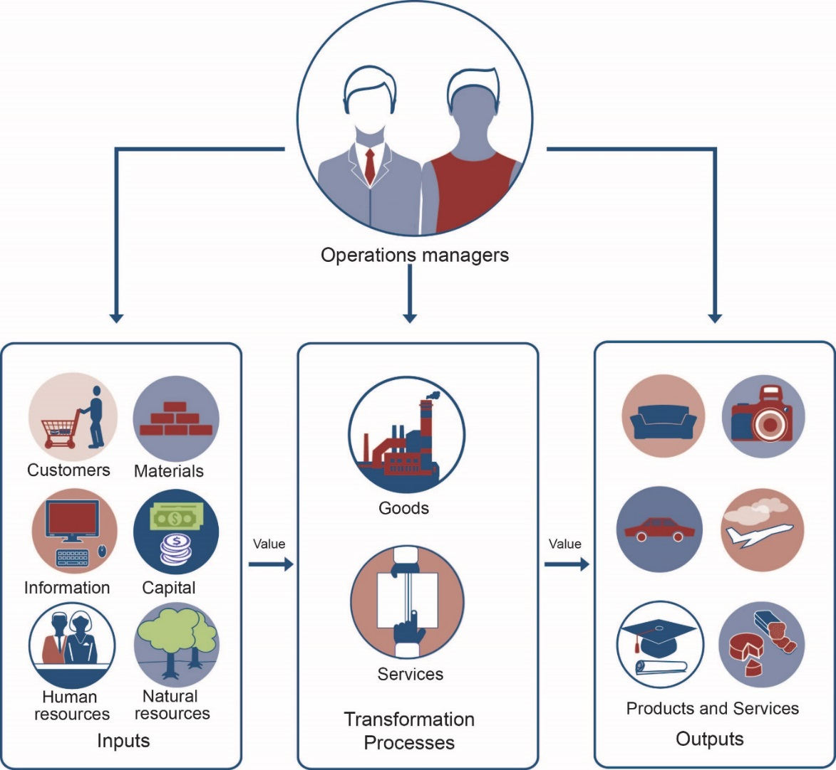
Operations management
Converting resources into goods or services
Video: What is Operations Management?
Notes:
Image: course textbook

Slide 4
Supply chain and value chain management
Supply chain (operations management perspective): the integration of all activities involved in the process of sourcing, procurement, conversion, logistics
Starts with manufacturing of raw material, ends with the product in the customer’s hands
Goals are operational: to increase efficiency, integrate supplier/producer processes, reduce waste, etc.
Value chain (customer perspective): a series of business operations in which utility is added to the goods and services offered by a firm to enhance customer value
Same supply chain actors/functions, but also includes activities such as marketing and after-sales service
Goal is to increase value to customer
Notes:
Definitions: https://keydifferences.com/difference-between-supply-chain-and-value-chain.html

Slide 5
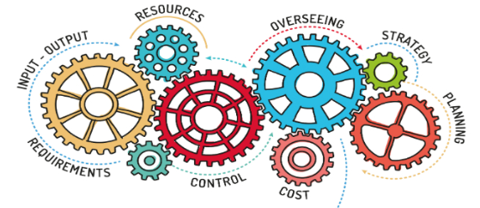
Operations management activities
Production planning
Where and how
Production control
Schedule and monitor
Quality control
Meet standards and expectations
Notes:
Image: https://www.channelfutures.com/files/2018/05/Operations-Management-2018.jpg

Slide 6

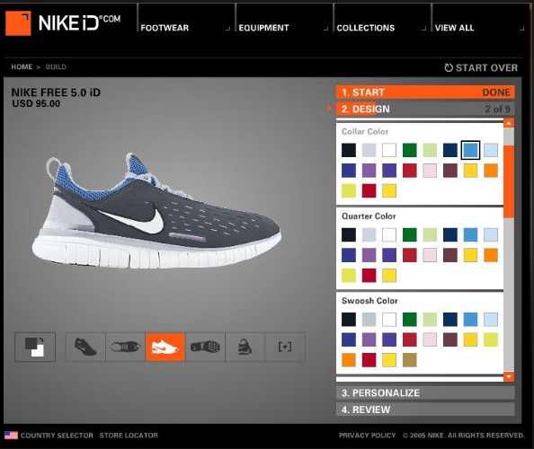
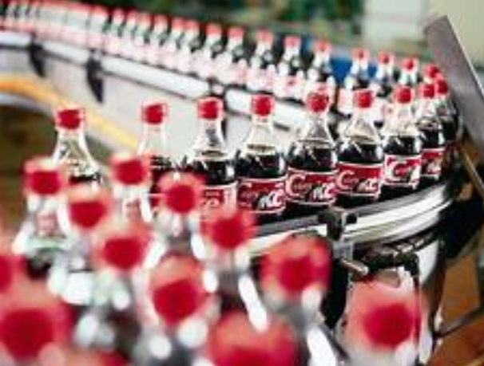
Types of production processes
Made-to-order (e.g., customized earbuds)
Mass production (e.g., automobiles)
Mass customization (e.g., personalized M&M’s)
Notes:
Image:
https://i.dmarge.com/2018/05/Brent-Wilson-suit-3-640x960.jpg
https://tse2.mm.bing.net/th?id=OIP.C7sFj1fulB3RDND8oZcPVAHaF-&pid=Api&P=0&w=228&h=185
http://photos1.blogger.com/blogger/7802/13/1600/createshoes.jpg

Slide 7

Production planning: site selection criteria
Locate close to…
Customers
Suppliers
Labour
Natural resources
Transportation
Quality of life
Low cost
Favourable government (e.g., tax credits)
Notes:
Image: https://bospar.com/wp-content/uploads/2016/08/Bospar-PR-Location-3.jpg

Slide 8
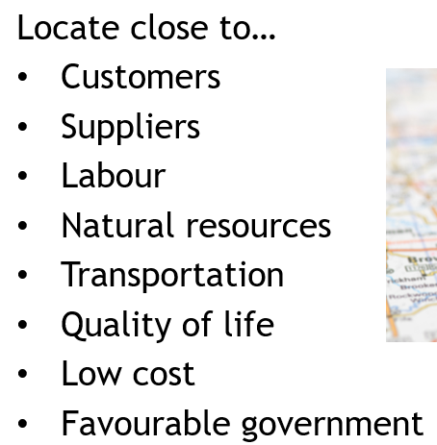
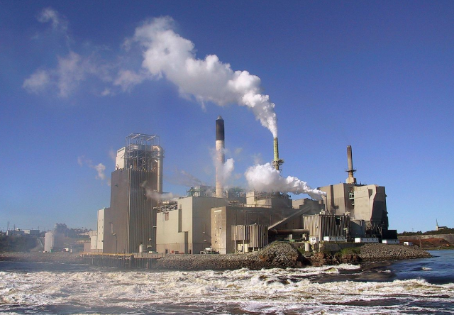

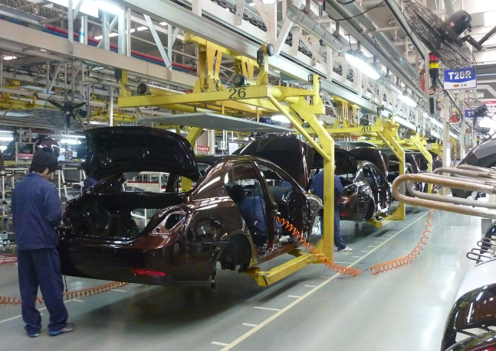
Production planning: Facilities site selection
Where would you locate a(n):
Paper mill?
New software venture?
Auto manufacturing facility?
Notes:
Images: https://upload.wikimedia.org/wikipedia/commons/thumb/2/29/PulpAndPaperMill.jpg/1200px-PulpAndPaperMill.jpg
https://spin.atomicobject.com/wp-content/uploads/first-job-2.jpg
https://upload.wikimedia.org/wikipedia/commons/thumb/5/55/Geely_assembly_line_in_Beilun%2C_Ningbo.JPG/1200px-Geely_assembly_line_in_Beilun%2C_Ningbo.JPG

Slide 9
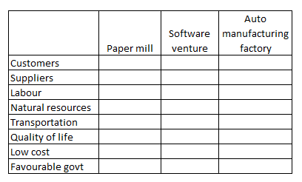
Hi-med-lo priority?

Slide 10

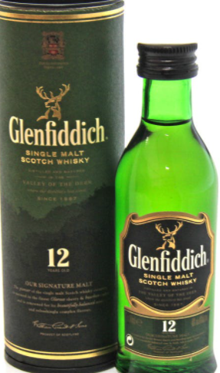



Production planning: Capacity planning
Forecast demand
Calculate capacity requirements
How would you decide how many units to produce?
Electric cars?
Smart phones?
12-year old Scotch whiskey?
Flowers (florist shop)?
Notes:
Image: https://www.linkedin.com/media-proxy/ext?w=1200&h=675&hash=jUZHnHfsKPtIt96L8Lr%2Faj9ys5E%3D&ora=1%2CaFBCTXdkRmpGL2lvQUFBPQ%2CxAVta5g-0R6plxVUzgUv5K_PrkC9q0RIUJDPBy-kXy2t-9SfZXPhfsbeZLSiol8eeCgEkwYwfOiqQzPiEo69LcLmY4Yx3A

Slide 11
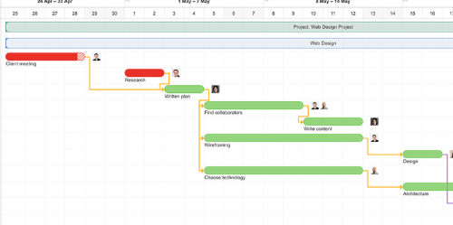
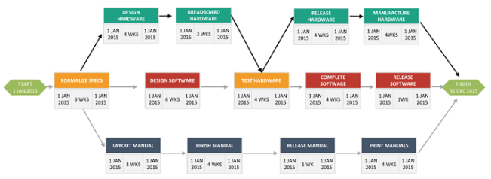
Production management
Procurement
Inventory control (e.g., just-in-time)
Materials requirements planning (MRP)
Convert sales forecast to master production schedule
Gantt and PERT charts
Notes:
Images:
https://www.sketchbubble.com/media/catalog/product/cache/1/image/720x540/c96a280f94e22e3ee3823dd0a1a87606/p/e/pert-chart-mc-slide3.png
https://www.paymoapp.com/wp-content/themes/paymo-new/public/img/gantt-chart-software/gantt-chart-software.png

Slide 12
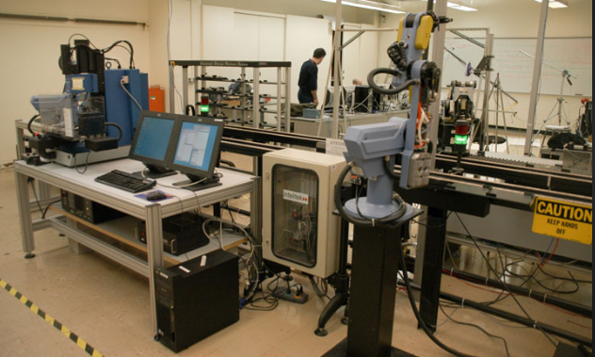

Production management: technology
Computer-aided design (CAD)
Computer-aided manufacturing (CAM)
Computer-integrated manufacturing (CIM)
Notes:
Image: http://technocad.in/wp/wp-content/uploads/2018/02/CAD-1-1.jpg
http://me-mechanicalengineering.com/wp-content/uploads/2016/02/computer-integrated-manufacturing-lab.jpg

Slide 13
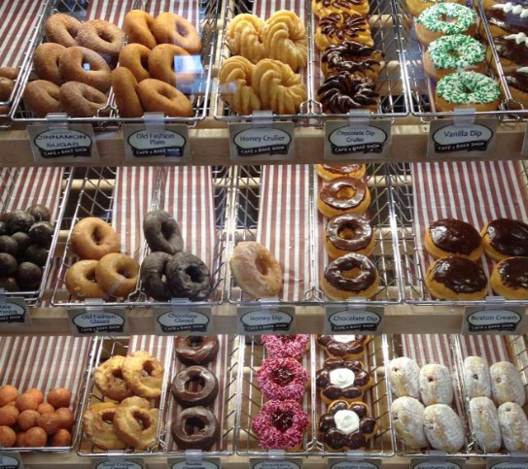

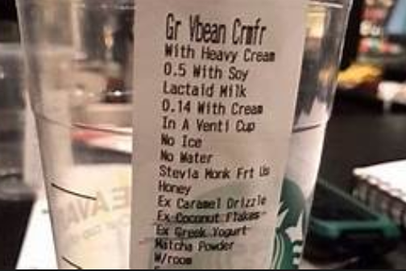
Service operations management
Services:
Intangible
Often customized
Have high customer contact
Some service businesses may also produce made-to-order or made-to-stock goods
Notes:
Image: https://www.selective.com/~/media/Images/S/Selective/content-images/our-insurance/service-businesses.jpg?h=471&la=en&w=760
https://tse1.mm.bing.net/th?id=OIP.K1xvFx_Vzlx7G6dA9F2P8AHaEL&pid=Api&P=0&w=285&h=161

Slide 14
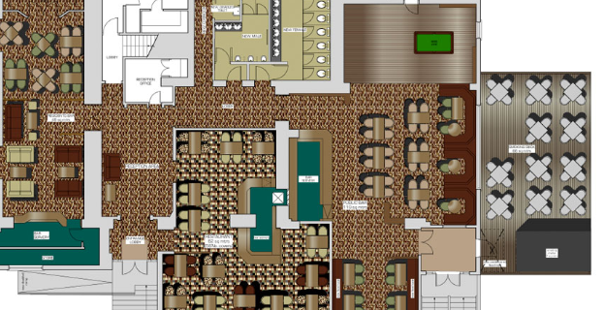
Service operations: planning
Site selection
Near customers
Size and layout
To be efficient
To meet customer needs
Capacity planning
Number of customers
When customers need service
Time to service a customer
Other factors, e.g. weather
Notes:
Image: http://www.georgesongroup.com/images/portfolio/hospitality/details_01.jpg
Traffic volume in London: https://maps.london.ca/CityMap/?run=ToggleLayer&mapServiceId=14&ext=475460.10266395955%2c4757239.925100273%2c482106.4492899861%2c4761024.532669489

Slide 15
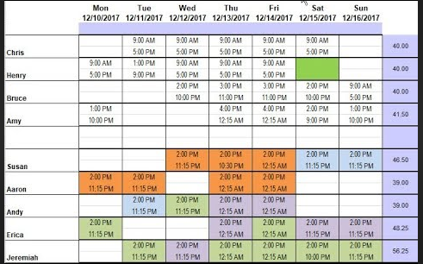
Service operations : management
Scheduling: who works when
Inventory control: similar to production management
Video: Amazon order fulfillment
Notes:
Image: https://i.ytimg.com/vi/h4lzuTMKn14/hqdefault.jpg

Slide 16
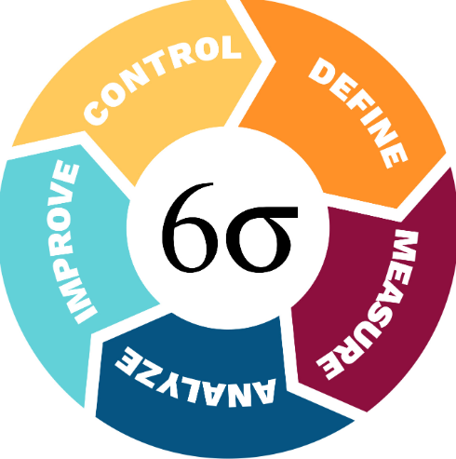
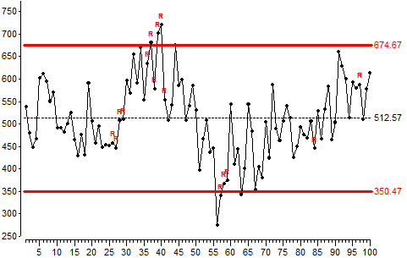
Managing quality
Total Quality Management (TQM) elements:
Customer Satisfaction
Meet customer needs at every stage
Get feedback and track
Employee involvement
Need commitment at every level
Provide training
Continuous process improvement
Tools include: statistical process control, Six Sigma, etc.
Notes:
Image: https://coloredbrain.com/wp-content/uploads/2017/06/sixsigmacircle_24184.jpg
http://datalyzer.com/statistical-process-control/wp-content/uploads/2015/03/statistical-process-control-l4-chart2.png

Slide 17

outsourcing
Note: not necessarily out of the country
Manufacturing
E.g., Apple uses Foxconn for manufacturing
Services
E.g., outsourcing payroll, call center
Notes:
Image: https://images.techhive.com/images/article/2014/10/outsourcing-thinkstock-100528175-large.jpg

Slide 18
Relevance for project managers and business owners
For Project Managers:
How are your deliverables going to be produced?
Procurement, quality assurance, Gantt, PERT, etc. are in PMBOK
For Business Owners:
You need to decide where/how to produce goods and services most efficiently
Operations management mistakes cost money and may result in unhappy customers

